Slide 1
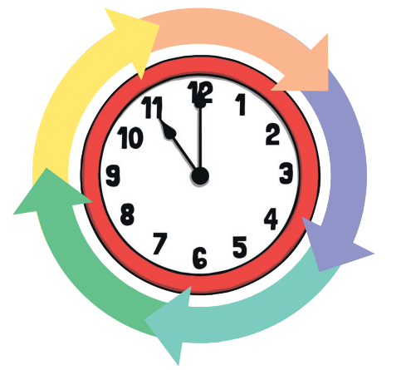
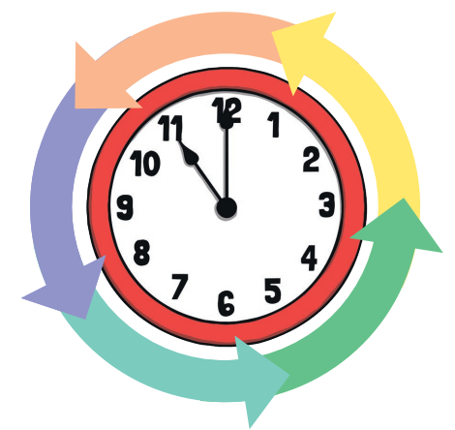
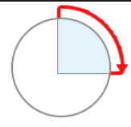
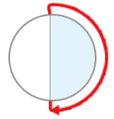
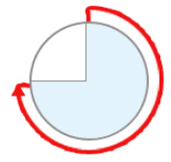
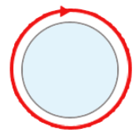
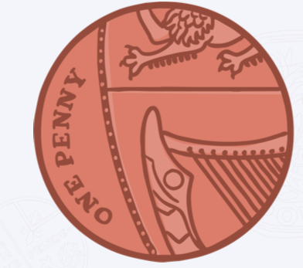
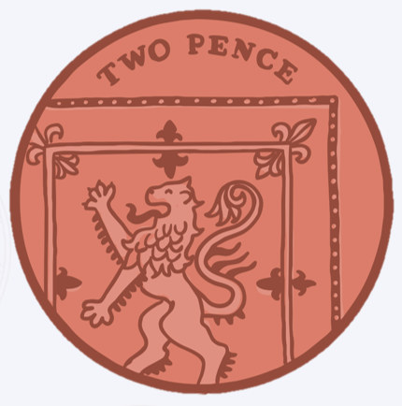
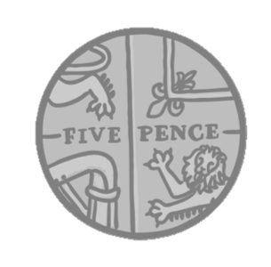
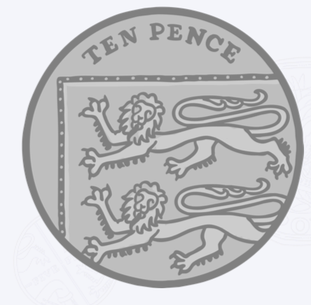
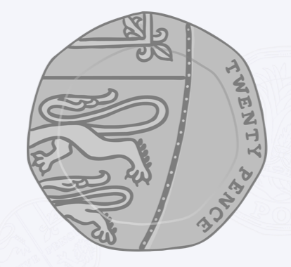
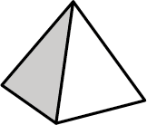
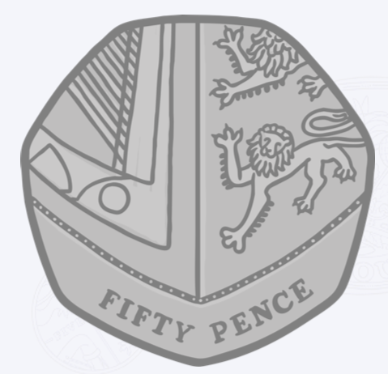
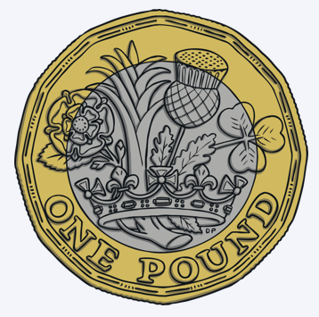
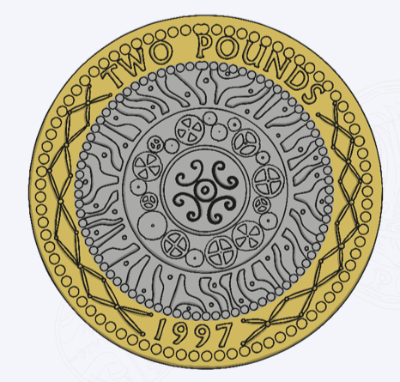
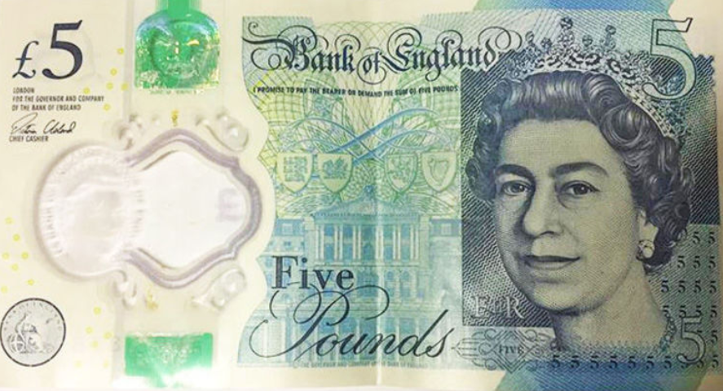
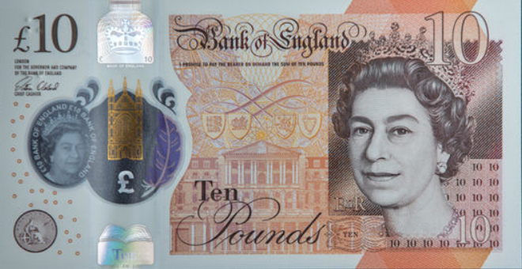

 | add plus
 | subtract minus
 | equals
Clockwise | Anti-clockwise
1 | one | 11 | eleven
2 | two | 12 | twelve
3 | three | 13 | thirteen
4 | four | 14 | fourteen
5 | five | 15 | fifteen
6 | six | 16 | sixteen
7 | seven | 17 | seventeen
8 | eight | 18 | eighteen
9 | nine | 19 | nineteen
10 | ten | 20 | twenty
Months of the Year | Months of the Year
1st | January
2nd | February
3rd | March
4th | April
5th | May
6th | June
7th | July
8th | August
9th | September
10th | October
11th | November
12th | December
Clockwise
quarter turn | half turn
three-quarter turn | full turn
Days of the Week
Monday
Tuesday
Wednesday
Thursday
Friday
Saturday
Sunday
2D Shapes | Example
3D Shapes | Example
One pence
1p
Two pence
2p
Five pence
5p
Ten pence
10p
Twenty pence
20p
circle
rectangle
cube
cuboid
Fifty pence
50p
One pound
£1
Two pounds
£2
Five pounds
£5
Ten pounds
£10
square
triangle
sphere
pyramid

